Slide 1

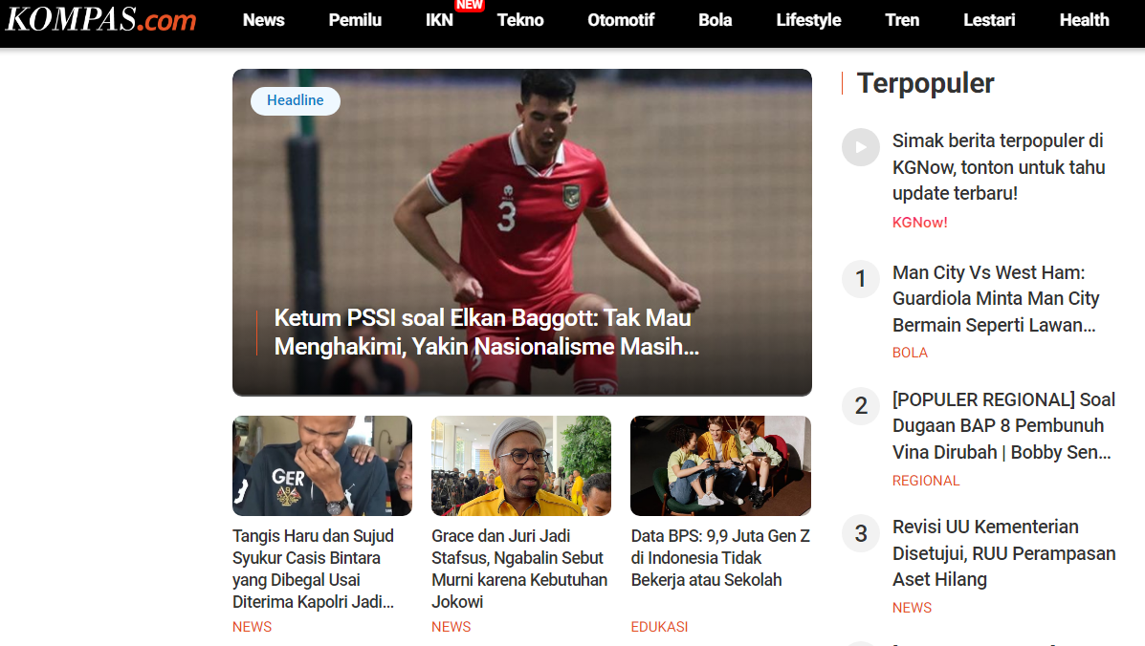
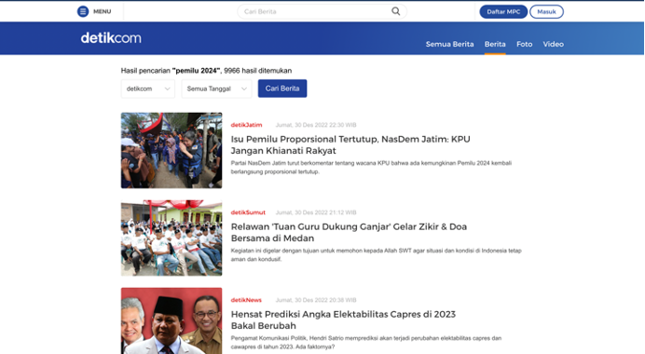
Clickbait Detection in Multilingual News Using BERT
Naurah Nazhifah

Slide 2
Introduction
News
Several News Sites
Indonesia : Detik, Fimela, Kapanlagi, Kompas, Liputan6, Republika, Sindonews, Tempo, Tribunnews, Okezone, Wowkeren, dan Posmetro-Medan
Inggris : BuzzFeed, Upworthy, ViralNova, Thatscoop, Scoopwhoop dan ViralStories.
Deep Learning Approach

Slide 3
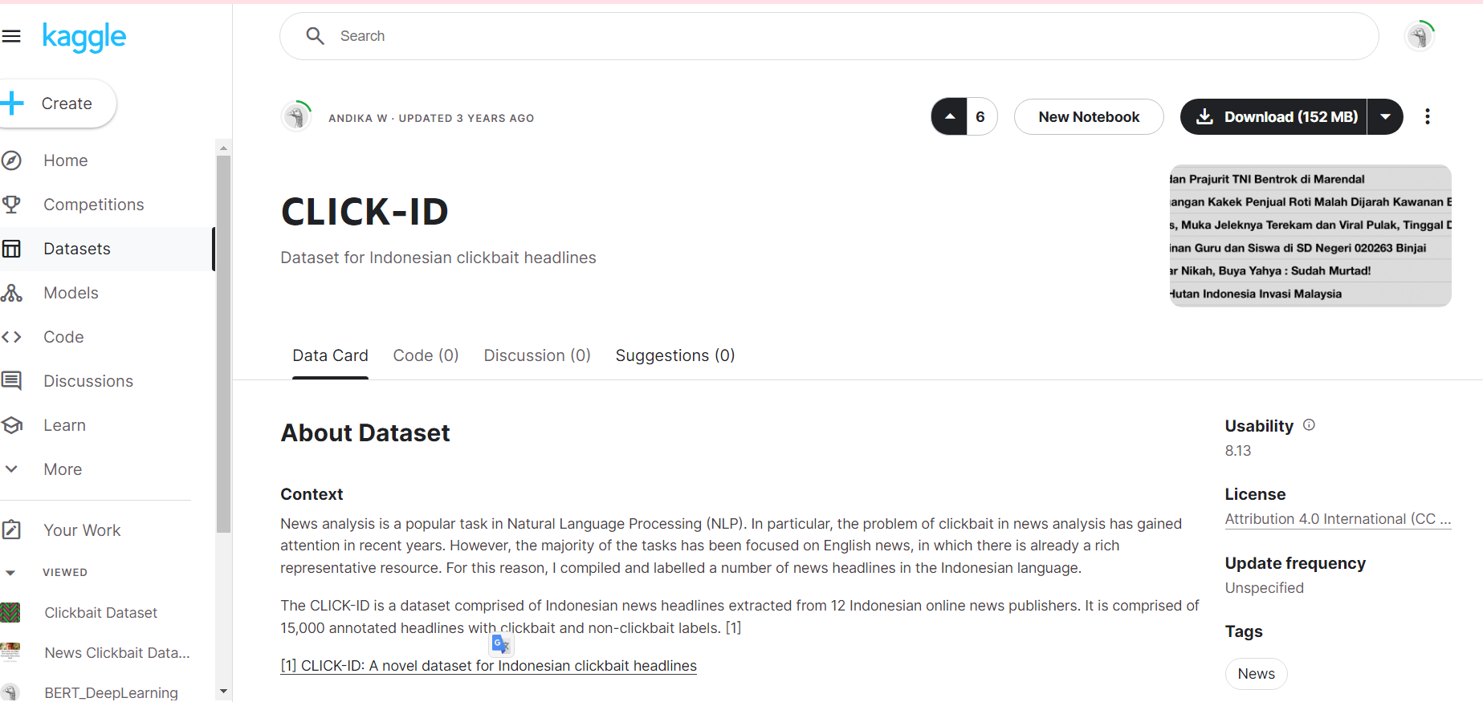
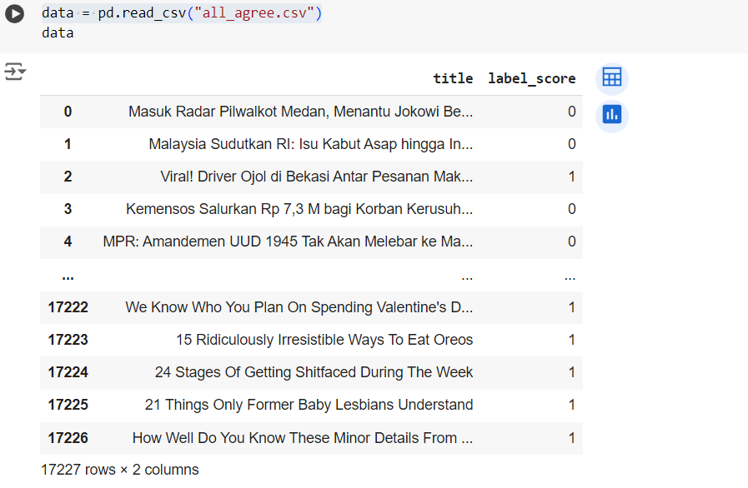
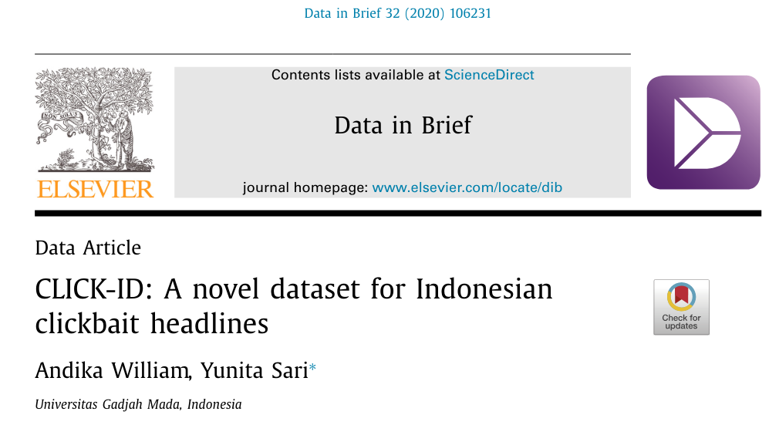
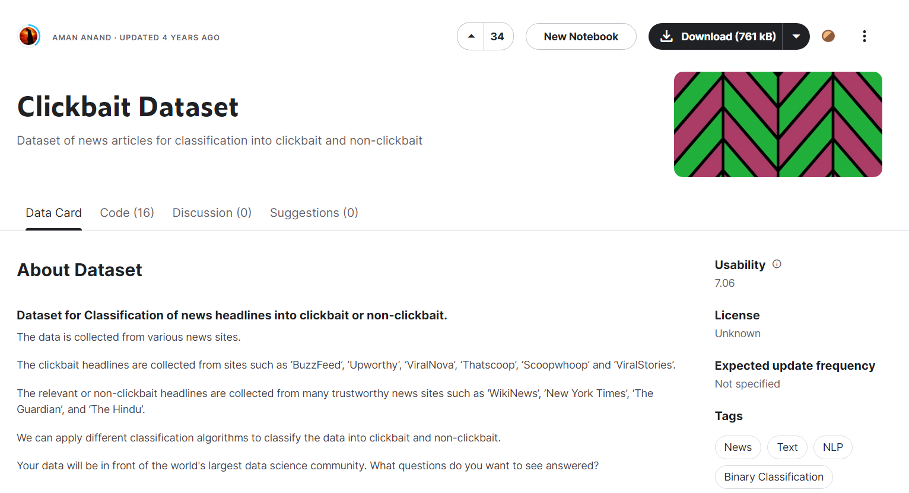
Methodology
Data

Slide 4
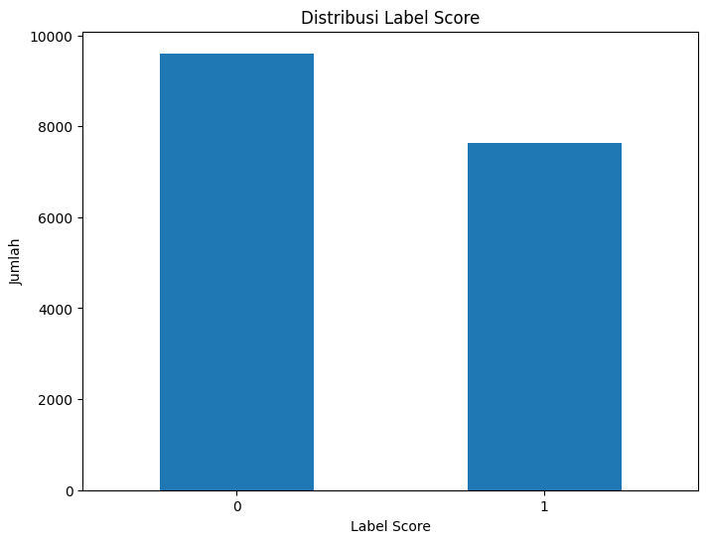
Distribusi Label
Label Score | Jumlah
0 | 9604
1 | 7623

Slide 5
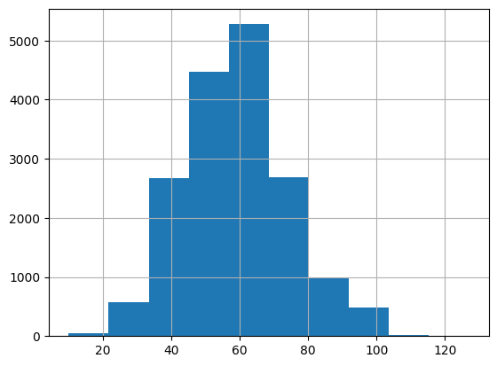
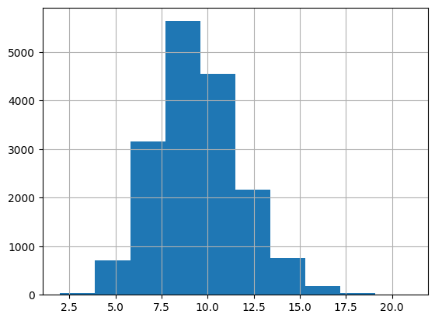
Number of characters present in each sentence
Number of Words Appearing in Each Title
The histogram shows that headlines range from 10 to 120 characters and generally, it isnews between 40 to 80 characters.
It is clear that the number of words in the title column ranges from 2 to 17 words and most of them range from 5 to 12 words.

Slide 6
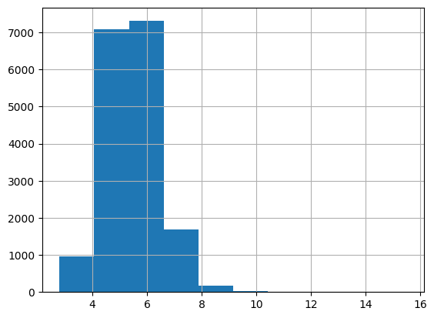
Average Word Length
Average word length ranges from 3 to 10 with 6 being the most common word length.

Slide 7
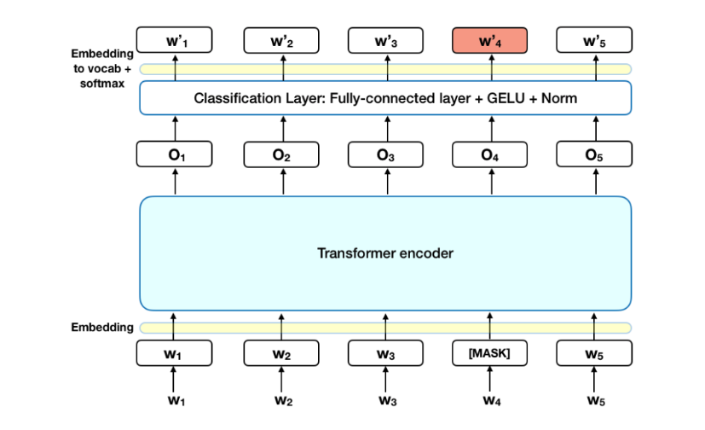
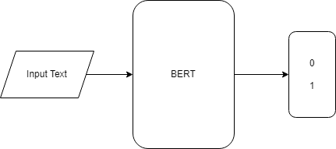
Preprocessing
Tokenizing
Using pre-trained BERT-Tokenizer
Architecture - Bert
Parameters
optimizer | AdamW
learning rate on bert | 1e-5
learning rate on feed forward layers | 1e-3
hidden dimension | 768
embedding dimension | 768

Slide 8
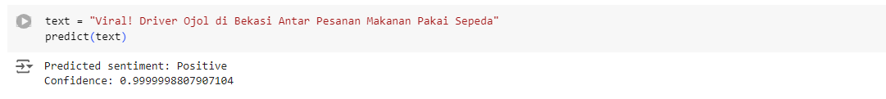
Result
Evaluation - BERT
Architecture | Classification
Bert | F1-score | 0.957
Check
The model can classify aspects and sentiments correctly

Slide 9
Terima Kasih

